Slide 1
Daily Review
CFU 1
How many options must each characteristic have?
Drawing Branched Dichotomous Keys
Step 1: List characteristics that could be used to separate the objects
Step 2: Pick one characteristic to divide the objects into two groups
Step 3: Look at the objects in each new group and choose a different characteristic to split the group further
Step 4: Repeat step 3 until all objects are individually identified
CFU 2
Create a branched key which could be used to identify the following objects: Smartphone Laptop iPad Surface Desktop computer
Vocabulary
cha·rac·ter·is·tic (noun) a feature or quality

Slide 2
Classification of Living Things Year 7 Science

Slide 3
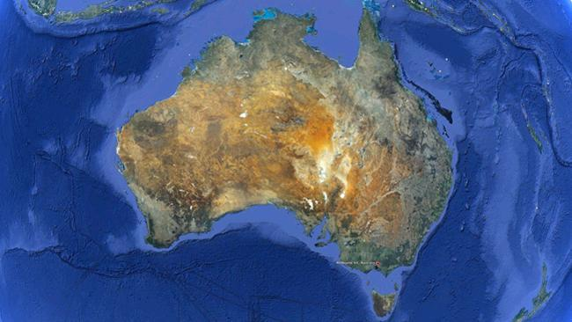
Learning Objectives
CFU 1
How many levels of classification are there?
List the seven levels of classification of living things
Use the binomial system of naming
CFU 2
What does binomial mean?
Activate Prior Knowledge
If you were trying to find your house on Google Earth, the first thing you would need to find would be the country you live in (Australia).
Where would you go next?
Where would you go after that? And after that?
You gradually narrow your search – to your city or town, your suburb, your street, and finally your house.
Vocabulary
bi·no·mi·al (adjective) having or using two names

Slide 4
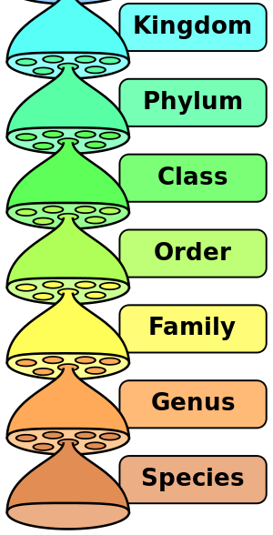
Concept Development
CFU 1
What is the largest group of living things?
Levels of Classification
Classifying living things starts with large groups called kingdoms (e.g. animals and plants)
A kingdom is divided into smaller groups called phyla (e.g. animals with backbones, bugs)
Each phylum has several classes (e.g. mammals, birds)
A class is divided into orders (e.g. primates, rodents) and so on until you reach a single species.
CFU 2
What is the smallest group of living things? (Be careful!)
CFU 3
Fill in the blanks: Every order is divided into ________. Every family is divided into ________.
Vocabulary
class·i·fy (verb) to divide things or people into groups according to their type

Slide 5
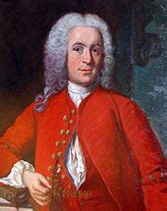
Skill Development / Guided Practice
A simple phrase can be used to remember the order of the levels of classification. For example:
Kingdom Kings Kids Katie,
Phylum Park Playing Please
Class Can Cricket Come
Order Offer OR On OR Over
Family Families Freeways For
Genus Great Get Great
Species Scenery Squashed Snacks
Did you know?
This classification system is called the Linnaean taxonomy, after Carl Linnaeus. Linnaeus invented the system more than 200 years ago!
Notes:
Have students write one or two of the mnemonics only – whichever ones they think they will remember best.
The system has, of course, been updated significantly since then.

Slide 6
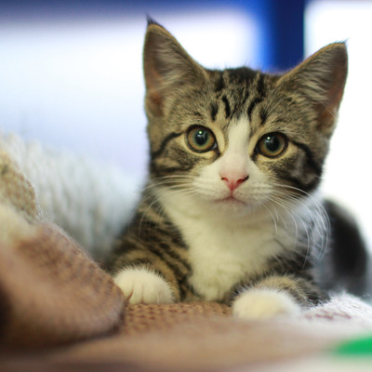
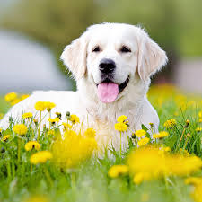
Skill Development / Guided Practice
CFU 1
Which two levels of classification are used in a binomial name?
The Binomial (double-name) Naming System
An organism is given a scientific name using the last two levels of its classification (genus and species).
Felis catus
CFU 2
Which comes first in a scientific name: genus or species?
Genus name with capital letter
Species name, no capital letter
CFU 3
Which name is capitalised?
Name written in italics (sloping letters)
CFU 4
Harold says the scientific name for a domestic dog is canis Familiaris. Is he correct? Explain your choice.

Slide 7
Skill Development / Guided Practice
CFU 1
Which two languages are often used in scientific names?
The Binomial (double-name) Naming System
Most scientific names are based on Latin and Greek words (though some include the name of the person who discovered the organism).
For example:
CFU 2
What might the common name for Canis rufus be?
CFU 3
Think, Pair, Share: which three words could you use to describe a koala?
What it does |  | What it looks like |  | Its body
Word | Meaning | Word | Meaning | Word | Meaning
amphi | half | aculeat | spiny | arctos | bear
bios | life | cinereus | grey | canis | wolf / dog
malus | bad | rufus | red | phascolo | pouch
CFU 4
Think, Pair, Share: frogs and salamanders spend part of their lives in water and part on land. Why are they called amphibians?

Slide 8
Relevance
Knowing how an organism is classified can tell you a lot about it!
Binomial names are a useful way of distinguishing between very similar organisms (e.g. different varieties of a plant).
Skill Closure
List the 7 levels of classification in order.
Which two levels of classification are used in a scientific name?
Which is the correct way to write the scientific name of a banana? Explain your choice.
Musa sapientum
musa sapientum
Musa sapientum
Musa Sapientum

Slide 9
Independent Practice
Reminder:
The seven levels of classification are: Kingdom Phylum Class Order Family Genus Species
Write your own phrase that you could use to remember the seven levels of classification.
Complete the Scientific Naming worksheet.

